Slide 1



CAMZ: Classification of Anxiety behavior through Multi-stage learning in Zebrafish
Chittathuru Himala Praharsha Nithin V. Shenoy Jocelyn Jose
Deep Intelligence Learning Lab
School of Data Science,
Indian Institute of Science Education and Research
Thiruvananthapuram
Molecular Neuro Development Lab
School of Biology,
Indian Institute of Science Education and Research
Thiruvananthapuram

Slide 2
CAMZ Slide No. 2
Contents
Table of Contents
Background
Overview
STAGE-I : Detection
STAGE-II : Classification
Deep Intelligence Learning Lab, IISER TVM
Table of Contents

Slide 3
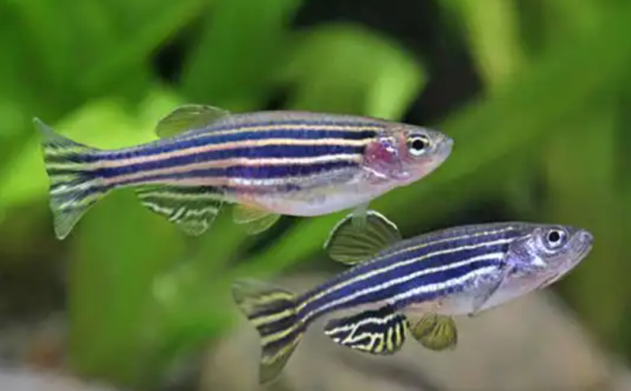
CAMZ Slide No. 3
Zebrafish Introduction
Background
Zebra Fishes are used for neuro drug experiments to analyse drugs performance
It can be used to determine the efficacy of the drug
If the fish undergoes behavioral changes i.e drug is working
The behavior is divided into two classes 1. Anxious 2. Not Anxious/Normal
Videos of fish behavior is analyzed by observing manually
This can be automated to reduce human error, time and resources being spent
There are no specific FEATURES to determine the behavior
Image: Animallifeexpectancy.com
Deep Intelligence Learning Lab, IISER TVM
Background

Slide 4
CAMZ Slide No. 4
Contents
Table of Contents
Background
Overview
STAGE-I : Detection
STAGE-II : Classification
Deep Intelligence Learning Lab, IISER TVM
Table of Contents

Slide 5
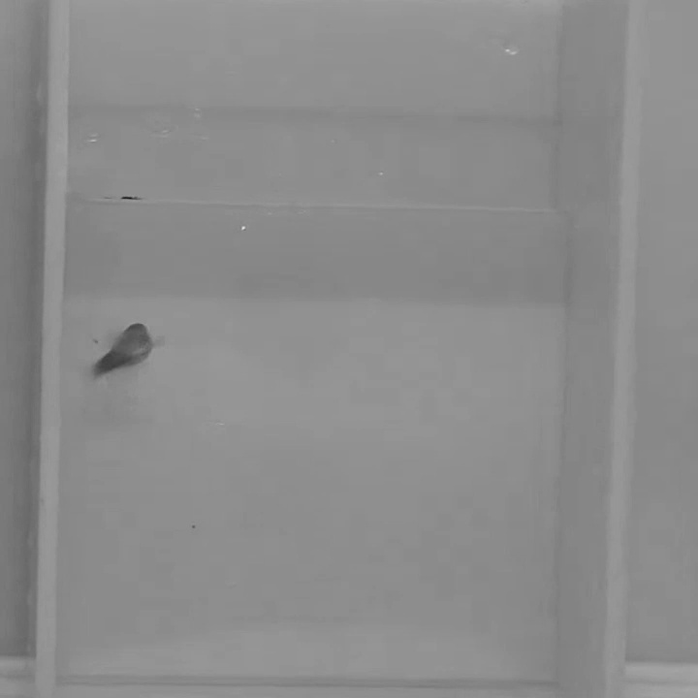
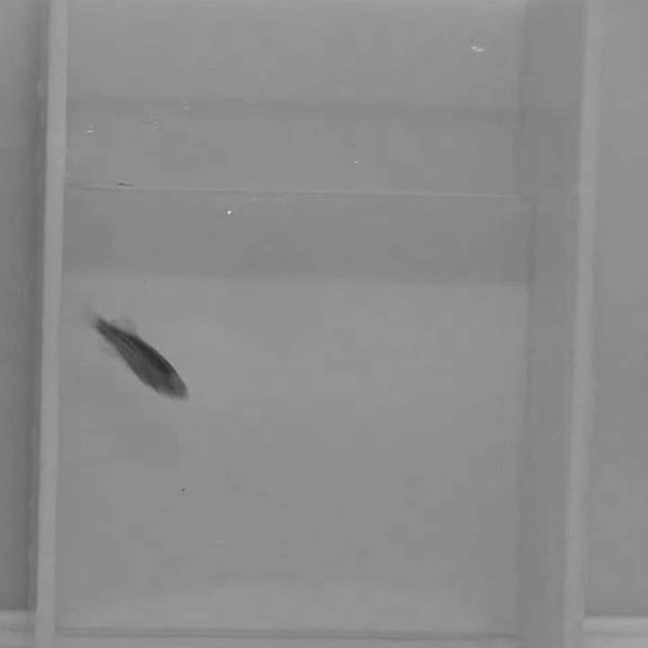
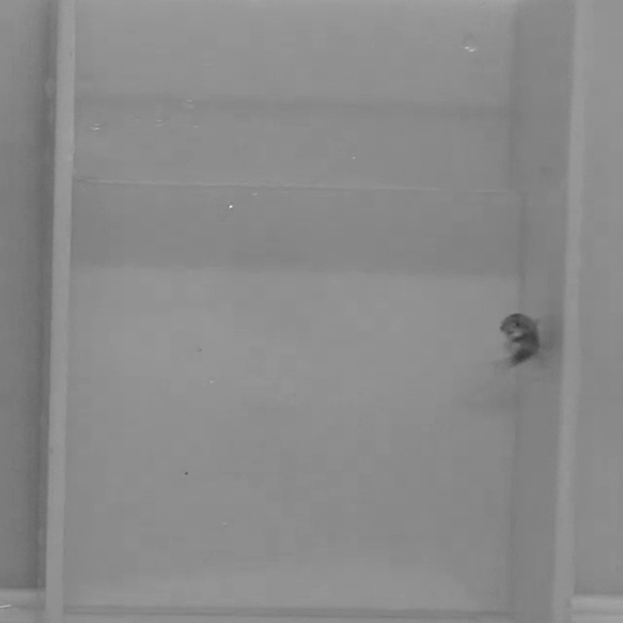

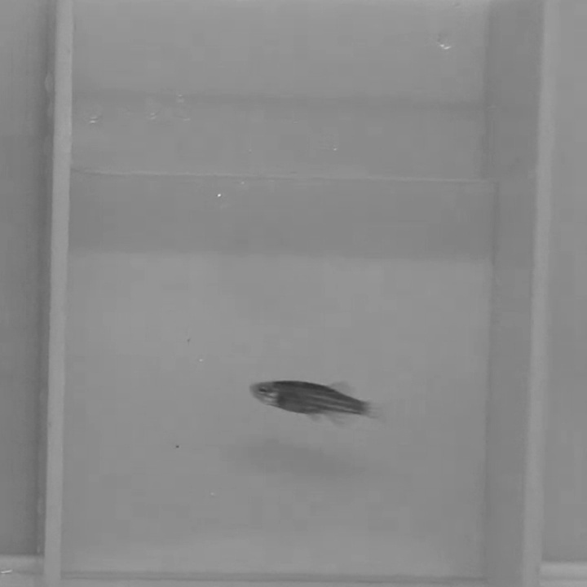
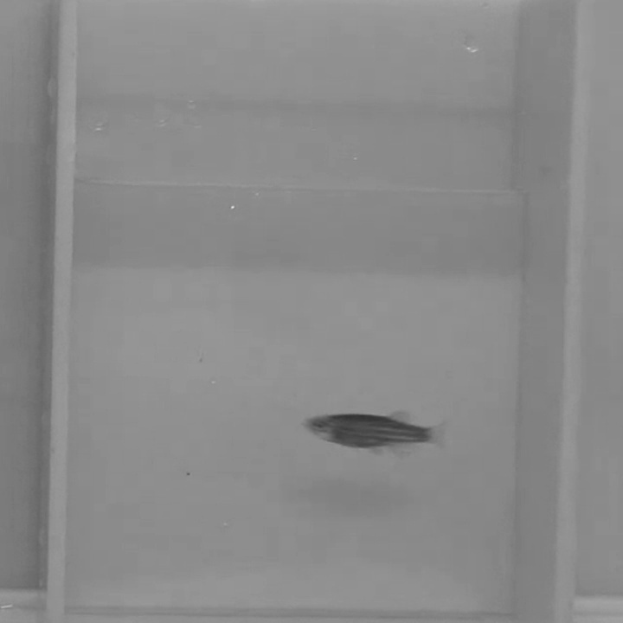
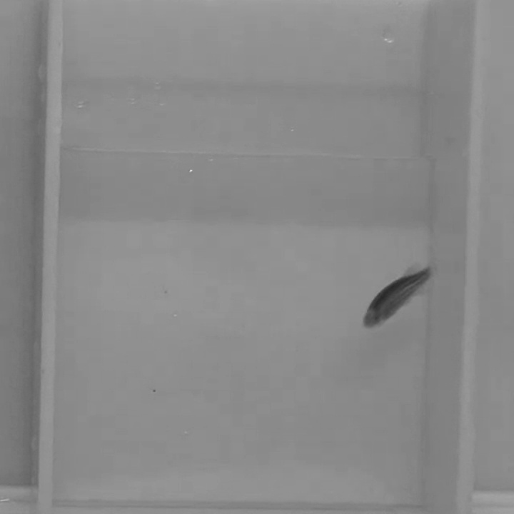




CAMZ Slide No. 5
Detection and Classification Pipeline
Overview
STAGE – I : Detection using Semi-supervised Learning
1
Iterative training with labelled and un-labelled image data for Zebrafish detection
1
2
2
Deployment of CNN model on Video data to retrieve Zebrafish bounding box information
Image Data
(labelled/Un-labelled)
CNN Model
Video Data
3
Pre-processing Bounding box information
STAGE – II : Classification using Supervised Learning
4
Training Model with bounding box information using video data labelled by experts
Anxious
5
Classification of Zebrafish anxiety behavior
5
4
3
Not-Anxious (Normal)
Model
Deep Intelligence Learning Lab, IISER TVM
Overview

Slide 6
CAMZ Slide No. 6
Contents
Table of Contents
Background
Overview
STAGE-I : Detection
STAGE-II : Classification
Deep Intelligence Learning Lab, IISER TVM
Table of Contents

Slide 7

CAMZ Slide No. 7
Detection Pipeline
STAGE-I : Detection
STAGE – I : Detection using Semi-supervised Learning
1
1
Model training with labelled image data
5
2
Model deployment on un-labelled
data
Labelled Image Data
Video Data
3
Pseudo labels assigned to un-labelled images
CNN Model
4
4
Pseudo labelled images combined with true labelled image data
2
5
Iteratively trained CNN model deployed on video data to retrieve bounding box information
Bounding Box information (Time dependent)
Un-labelled Image Data
Pseudo-labels
3
Deep Intelligence Learning Lab, IISER TVM
Detection

Slide 8
CAMZ Slide No. 8
Detection Pipeline
STAGE-I : Detection
Note:
In iterative training of labelled-unlabelled data, The CNN model is validated on labelled data!
1
5
Labelled Image Data
Video Data
CNN Model
4
2
Bounding Box information (Time dependent)
Un-labelled Image Data
Pseudo-labels
3
Deep Intelligence Learning Lab, IISER TVM
Detection

Slide 9
CAMZ Slide No. 9
Contents
Table of Contents
Background
Overview
STAGE-I : Detection
STAGE-II : Classification
Deep Intelligence Learning Lab, IISER TVM
Table of Contents

Slide 10
CAMZ Slide No. 10
Classification Pipeline
STAGE-II: Classification
STAGE – II : Classification using Supervised Learning
Anxious
Not-Anxious (Normal)
Bounding Box information (Time dependent)
Pre-processing Bounding box information
Model
Deep Intelligence Learning Lab, IISER TVM
Classification

Slide 11
CAMZ Slide No. 11
Q&A
Thank You!
Deep Intelligence Learning Lab, IISER TVM
Summing up

